Slide 1
EXCEPTION HANDLING…
Anisha P Rodrigues, Dept of CSE, NMAMIT, Nitte

Slide 2
3 Categories of Exceptions
Checked exceptions:
A checked exception is an exception that is typically a user error or a problem that cannot be foreseen by the programmer.
For example, if a file is to be opened, but the file cannot be found, an exception occurs
These exceptions cannot simply be ignored at the time of compilation.
Anisha P Rodrigues, Dept of CSE, NMAMIT, Nitte

Slide 3
Runtime exceptions:
A runtime exception is an exception that occurs that probably could have been avoided by the programmer.
As opposed to checked exceptions, runtime exceptions are ignored at the time of compilation.
Anisha P Rodrigues, Dept of CSE, NMAMIT, Nitte

Slide 4
Errors:
These are not exceptions at all, but problems that arise beyond the control of the user or the programmer
Errors are typically ignored in your code because you can rarely do anything about an error
For example, if a stack overflow occurs, an error will arise
They are also ignored at the time of compilation
Anisha P Rodrigues, Dept of CSE, NMAMIT, Nitte

Slide 5
A Java exception is an object that describes an exceptional (that is, error) condition that has occurred in a piece of code
When an exceptional condition arises, an object representing that exception is created and thrown in the method that caused the error
The exception is caught and processed
Anisha P Rodrigues, Dept of CSE, NMAMIT, Nitte

Slide 6
Java exception handling is managed via five keywords: try, catch, throw, throws, and finally
try-catch
We use try-catch block for exception handling in our code
try is the start of the block and catch is at the end of try block to handle the exceptions
We can have multiple catch blocks with a try and try-catch block can be nested also
catch block requires a parameter that should be of type Exception
Anisha P Rodrigues, Dept of CSE, NMAMIT, Nitte

Slide 7
finally
finally block is optional and can be used only with try-catch block
Since exception halts the process of execution, we might have some resources open that will not get closed, so we can use finally block
finally block gets executed always, whether exception occurred or not
Anisha P Rodrigues, Dept of CSE, NMAMIT, Nitte

Slide 8
throw
We know that if any exception occurs, an exception object is getting created and then Java runtime starts processing to handle them
Sometime we might want to generate exception explicitly in our code, for example in a user authentication program we should throw exception to client if the password is null
throw keyword is used to throw exception to the runtime to handle it
Anisha P Rodrigues, Dept of CSE, NMAMIT, Nitte

Slide 9
throws
When we are throwing any exception in a method and not handling it, then we need to use throws keyword in method signature to let caller program know the exceptions that might be thrown by the method
The caller method might handle these exceptions or propagate it to it’s caller method using throws keyword
We can provide multiple exceptions in the throws clause and it can be used with main() method also
Anisha P Rodrigues, Dept of CSE, NMAMIT, Nitte

Slide 10
Program statements that you want to monitor for exceptions are contained within a try block
If an exception occurs within the try block, it is thrown
Your code can catch this exception (using catch) and handle it
Anisha P Rodrigues, Dept of CSE, NMAMIT, Nitte

Slide 11
System-generated exceptions are automatically thrown by the Java run-time system
To manually throw an exception, use the keyword throw
Any exception that is thrown out of a method must be specified as such by a throws clause
Any code that absolutely must be executed before a method returns is put in a finally block
Anisha P Rodrigues, Dept of CSE, NMAMIT, Nitte

Slide 12
This is the general form of an exception-handling block:
try {
// block of code to monitor for errors
}
catch (ExceptionType1 exOb) {
// exception handler for ExceptionType1
}
catch (ExceptionType2 exOb) {
// exception handler for ExceptionType2
}
// ...
finally {
// block of code to be executed before try block ends
}
Anisha P Rodrigues, Dept of CSE, NMAMIT, Nitte

Slide 13
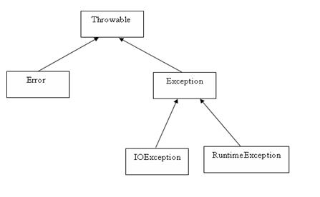
Exception Types
All exception classes are subtypes of the java.lang.Exception class
Anisha P Rodrigues, Dept of CSE, NMAMIT, Nitte

Slide 14
Exception Types
All exception types are subclasses of the built-in class Throwable
Immediately below Throwable are two subclasses that partition exceptions into two distinct branches
One branch is headed by Exception
This class is used for exceptional conditions that user programs should catch
Anisha P Rodrigues, Dept of CSE, NMAMIT, Nitte

Slide 15
There is an important subclass of Exception, called RuntimeException
Exceptions of this type are automatically defined for the programs that you write and include things such as division by zero and invalid array indexing
Anisha P Rodrigues, Dept of CSE, NMAMIT, Nitte

Slide 16
The other branch is topped by Error, which defines exceptions that are not expected to be caught under normal circumstances by your program
Exceptions of type Error are used by the Java run-time system to indicate errors having to do with the run-time environment, itself
Stack overflow is an example of such an error
Anisha P Rodrigues, Dept of CSE, NMAMIT, Nitte

Slide 17
Uncaught Exceptions…
This small program includes an expression that intentionally causes a divide-by-zero error:
class Exc0 {
public static void main(String args[]) {
int d = 0;
int a = 42 / d;
}
}
Anisha P Rodrigues, Dept of CSE, NMAMIT, Nitte

Slide 18
When the Java run-time system detects the attempt to divide by zero, it constructs a new exception object and then throws this exception
This causes the execution of Exc0 to stop, because once an exception has been thrown, it must be caught by an exception handler and dealt with immediately
Anisha P Rodrigues, Dept of CSE, NMAMIT, Nitte

Slide 19
In this example, we haven’t supplied any exception handlers of our own, so the exception is caught by the default handler provided by the Java run-time system
Any exception that is not caught by your program will ultimately be processed by the default handler
Anisha P Rodrigues, Dept of CSE, NMAMIT, Nitte

Slide 20
The default handler displays a string describing the exception, prints a stack trace from the point at which the exception occurred, and terminates the program
Here is the exception generated when this example is executed:
java.lang.ArithmeticException: / by zero
at Exc0.main(Exc0.java:4)
Notice how the class name, Exc0; the method name, main; the filename, Exc0.java; and the line number, 4, are all included in the simple stack trace
Anisha P Rodrigues, Dept of CSE, NMAMIT, Nitte

Slide 21
Also, notice that the type of exception thrown is a subclass of Exception called ArithmeticException, which more specifically describes what type of error happened
Anisha P Rodrigues, Dept of CSE, NMAMIT, Nitte

Slide 22
Using try and catch
Handling an exception manually provides two benefits
First, it allows you to fix the error
Second, it prevents the program from automatically terminating
Anisha P Rodrigues, Dept of CSE, NMAMIT, Nitte

Slide 23
class Exc2 {
public static void main(String args[]) {
int d, a;
try { // monitor a block of code.
d = 0;
a = 42 / d;
System.out.println("This will not be printed.");
} catch (ArithmeticException e) { // catch divide-by-zero error
System.out.println("Division by zero.");
}
System.out.println("After catch statement.");
}
}
This program generates the following output:
Division by zero.
After catch statement.
Anisha P Rodrigues, Dept of CSE, NMAMIT, Nitte

Slide 24
A try and its catch statement form a unit
The scope of the catch clause is restricted to those statements specified by the immediately preceding try statement
A catch statement cannot catch an exception thrown by another try statement
Anisha P Rodrigues, Dept of CSE, NMAMIT, Nitte

Slide 25
// Handle an exception and move on.
import java.util.Random;
class HandleError {
public static void main(String args[]) {
int a=0, b=0, c=0;
Random r = new Random();
for(int i=0; i<32000; i++) {
try {
b = r.nextInt();
c = r.nextInt();
a = 12345 / (b/c);
} catch (ArithmeticException e) {
System.out.println("Division by zero.");
a = 0; // set a to zero and continue
}
System.out.println("a: " + a);
}
}
}
Anisha P Rodrigues, Dept of CSE, NMAMIT, Nitte

Slide 26
Displaying a Description of an Exception
catch (ArithmeticException e) {
System.out.println("Exception: " + e);
a = 0; // set a to zero and continue
}
Exception: java.lang.ArithmeticException: / by zero
Anisha P Rodrigues, Dept of CSE, NMAMIT, Nitte

Slide 27
Multiple catch Clauses
// Demonstrate multiple catch statements.
class MultiCatch {
public static void main(String args[]) {
try {
int a = args.length;
System.out.println("a = " + a);
int b = 42 / a;
int c[] = { 1 };
c[42] = 99;
} catch(ArithmeticException e) {
System.out.println("Divide by 0: " + e);
} catch(ArrayIndexOutOfBoundsException e) {
System.out.println("Array index oob: " + e);
}
System.out.println("After try/catch blocks.");
}
}
Anisha P Rodrigues, Dept of CSE, NMAMIT, Nitte

Slide 28
/* This program contains an error. A subclass must come before its superclass in a series of catch statements. If not, unreachable code will be created and a compile-time error will result. */
class SuperSubCatch {
public static void main(String args[]) {
try {
int a = 0;
int b = 42 / a;
} catch(Exception e) {
System.out.println("Generic Exception catch.");
}
/* This catch is never reached because ArithmeticException is a subclass of Exception. */
catch(ArithmeticException e) { // ERROR - unreachable
System.out.println("This is never reached.");
}
}
}
Anisha P Rodrigues, Dept of CSE, NMAMIT, Nitte

Slide 29
Nested try Statements…
A try statement can be inside the block of another try
Each time a try statement is entered, the context of that exception is pushed on the stack
If an inner try statement does not have a catch handler for a particular exception, the stack is unwound and the next try statement’s catch handlers are inspected for a match
Anisha P Rodrigues, Dept of CSE, NMAMIT, Nitte

Slide 30
This continues until one of the catch statements succeeds, or until all of the nested try statements are exhausted
If no catch statement matches, then the Java run-time system will handle the exception
Anisha P Rodrigues, Dept of CSE, NMAMIT, Nitte

Slide 31
// An example of nested try statements.
class NestTry {
public static void main(String args[]) {
try {
int a = args.length;
/* If no command-line args are present, the following statement will generate a divide-by-zero exception. */
int b = 42 / a;
System.out.println("a = " + a);
try { // nested try block
/* If one command-line arg is used, then a divide-by-zero exception
will be generated by the following code. */
if(a==1)
a = a/(a-a); // division by zero
Anisha P Rodrigues, Dept of CSE, NMAMIT, Nitte

Slide 32
/* If two command-line args are used, then generate an out-of-bounds exception. */
if(a==2) {
int c[] = { 1 };
c[42] = 99; // generate an out-of-bounds exception
}
} catch(ArrayIndexOutOfBoundsException e) {
System.out.println("Array index out-of-bounds: " + e);
}
} catch(ArithmeticException e) {
System.out.println("Divide by 0: " + e);
}
}
}
Anisha P Rodrigues, Dept of CSE, NMAMIT, Nitte

Slide 33
When you execute the program with no command-line arguments, a divide-by-zero exception is generated by the outer try block
Execution of the program with one command-line argument generates a divide-by-zero exception from within the nested try block
Since the inner block does not catch this exception, it is passed on to the outer try block, where it is handled
If you execute the program with two command-line arguments, an array boundary exception is generated from within the inner try block
Anisha P Rodrigues, Dept of CSE, NMAMIT, Nitte

Slide 34
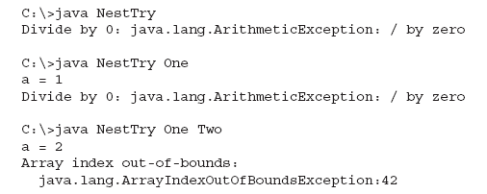
Sample output:
Anisha P Rodrigues, Dept of CSE, NMAMIT, Nitte

Slide 35
We can enclose a call to a method within a try block
Inside that method is another try statement
In this case, the try within the method is still nested inside the outer try block, which calls the method
Anisha P Rodrigues, Dept of CSE, NMAMIT, Nitte

Slide 36
/* Try statements can be implicitly nested via calls to methods. */
class MethNestTry {
static void nesttry(int a) {
try { // nested try block
/* If one command-line arg is used, then a divide-by-zero exception
will be generated by the following code. */
if(a==1) a = a/(a-a); // division by zero
/* If two command-line args are used, then generate an out-of-bounds exception. */
if(a==2) {
int c[] = { 1 };
c[42] = 99; // generate an out-of-bounds exception
}
} catch(ArrayIndexOutOfBoundsException e) {
System.out.println("Array index out-of-bounds: " + e);
}
}
Anisha P Rodrigues, Dept of CSE, NMAMIT, Nitte

Slide 37
public static void main(String args[]) {
try {
int a = args.length;
/* If no command-line args are present, the following statement will generate a divide-by-zero exception. */
int b = 42 / a;
System.out.println("a = " + a);
nesttry(a);
} catch(ArithmeticException e) {
System.out.println("Divide by 0: " + e);
}
}
}
The output of this program is identical to that of the preceding example.
Anisha P Rodrigues, Dept of CSE, NMAMIT, Nitte

Slide 38
throw
It is possible for your program to throw an exception explicitly, using the throw statement
The general form of throw is shown here:
throw ThrowableInstance;
Anisha P Rodrigues, Dept of CSE, NMAMIT, Nitte

Slide 39
Here, ThrowableInstance must be an object of type Throwable or a subclass of Throwable
There are two ways you can obtain a Throwable object: using a parameter into a catch clause, or creating one with the new operator
The flow of execution stops immediately after the throw statement; any subsequent statements are not executed
Anisha P Rodrigues, Dept of CSE, NMAMIT, Nitte

Slide 40
// Demonstrate throw.
class ThrowDemo {
static void demoproc() {
try {
throw new NullPointerException("demo");
} catch(NullPointerException e) {
System.out.println("Caught inside demoproc.");
throw e; // rethrow the exception
}
}
public static void main(String args[]) {
try {
demoproc();
} catch(NullPointerException e) {
System.out.println("Recaught: " + e);
} } }
Anisha P Rodrigues, Dept of CSE, NMAMIT, Nitte

Slide 41
Output:
Caught inside demoproc.
Recaught: java.lang.NullPointerException: demo
Anisha P Rodrigues, Dept of CSE, NMAMIT, Nitte

Slide 42
throws
If a method is capable of causing an exception that it does not handle, it must specify this behavior so that callers of the method can guard themselves against that exception
A throws clause lists the types of exceptions that a method might throw
Anisha P Rodrigues, Dept of CSE, NMAMIT, Nitte

Slide 43
Exceptions that a method can throw must be declared in the throws clause
This is the general form of a method declaration that includes a throws clause:
type method-name(parameter-list) throws exception-list
{
// body of method
}
Here, exception-list is a comma-separated list of the exceptions that a method can throw
Anisha P Rodrigues, Dept of CSE, NMAMIT, Nitte

Slide 44
// This program contains an error and will not compile.
class ThrowsDemo {
static void throwOne() {
System.out.println("Inside throwOne.");
throw new IllegalAccessException("demo");
}
public static void main(String args[ ]) {
throwOne();
}
}
Anisha P Rodrigues, Dept of CSE, NMAMIT, Nitte

Slide 45
class ThrowsDemo {
static void throwOne() throws IllegalAccessException {
System.out.println("Inside throwOne.");
throw new IllegalAccessException("demo");
}
public static void main(String args[]) {
try {
throwOne();
} catch (IllegalAccessException e) {
System.out.println("Caught " + e);
}
}
}
Here is the output generated by running this example program:
inside throwOne
caught java.lang.IllegalAccessException: demo
Anisha P Rodrigues, Dept of CSE, NMAMIT, Nitte

Slide 46
class Throwsdemo2
{
public void calledMethod() throws IOException{
BufferedReader bfr = new BufferedReader(new InputStreamReader(S ystem.in));
bfr.readLine();
}
}
public static void main(String args[]) {
try {
calledMethod(); // here the exception is handled
} catch (IOException e) {
System.out.println(“Exception " + e);
}
}
Anisha P Rodrigues, Dept of CSE, NMAMIT, Nitte

Slide 47
finally
finally creates a block of code that will be executed after a try/catch block has completed and before the code following the try/catch block
The finally block will execute whether or not an exception is thrown
If an exception is thrown, the finally block will execute even if no catch statement matches the exception
Anisha P Rodrigues, Dept of CSE, NMAMIT, Nitte

Slide 48
The finally clause is optional
Each try statement requires at least one catch or a finally clause
Anisha P Rodrigues, Dept of CSE, NMAMIT, Nitte

Slide 49
// Demonstrate finally.
class FinallyDemo {
// Through an exception out of the method.
static void procA() {
try {
System.out.println("inside procA");
throw new RuntimeException("demo");
} finally {
System.out.println("procA's finally");
}
}
// Return from within a try block.
static void procB() {
try {
System.out.println("inside procB");
return;
} finally {
System.out.println("procB's finally");
}
}
Anisha P Rodrigues, Dept of CSE, NMAMIT, Nitte

Slide 50
// Execute a try block normally.
static void procC() {
try {
System.out.println("inside procC");
} finally {
System.out.println("procC's finally");
}
}
public static void main(String args[]) {
try {
procA();
} catch (Exception e) {
System.out.println("Exception caught");
}
procB();
procC();
}
}
Anisha P Rodrigues, Dept of CSE, NMAMIT, Nitte

Slide 51
Here is the output generated by the preceding program:
inside procA
procA’s finally
Exception caught
inside procB
procB’s finally
inside procC
procC’s finally
Anisha P Rodrigues, Dept of CSE, NMAMIT, Nitte

Slide 52
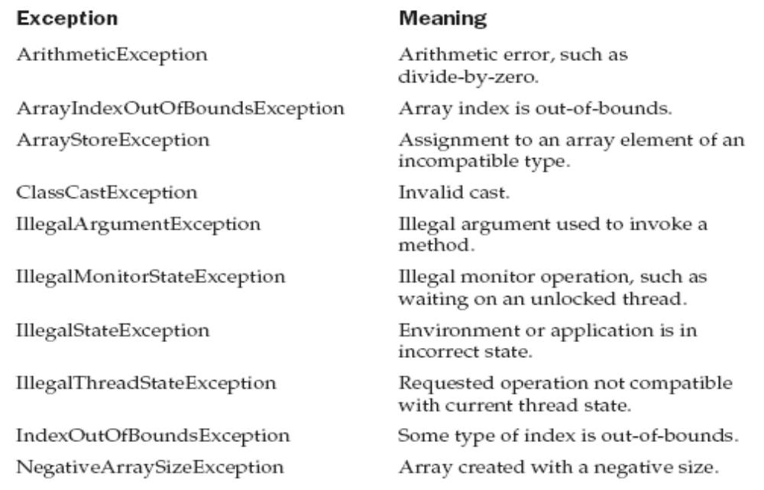
Java’s Built-in Exceptions…
Anisha P Rodrigues, Dept of CSE, NMAMIT, Nitte

Slide 53
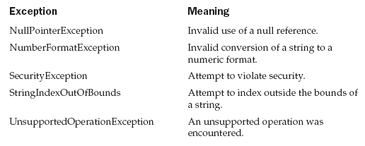
Anisha P Rodrigues, Dept of CSE, NMAMIT, Nitte

Slide 54
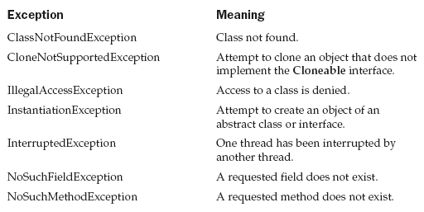
Anisha P Rodrigues, Dept of CSE, NMAMIT, Nitte

Slide 55
Thank You…
Anisha P Rodrigues, Dept of CSE, NMAMIT, Nitte

